Slide 1
Covid-19 Clock-In Application
Ryan Higgins, Daniel Gallagher, Shane McCormack, Jack McNamee
Supervisor Joseph Corr

Slide 2
Project Overview
An application that allows employees to clock in/clock out via their smartphone to help prevent the transmission of Covid-19 in the workplace.
The employee will only be able to clock in when they are in the workplace and will have to use their front-facing camera to confirm their identify.
The clock in times will be recorded for the manager to view, thus removing the need for a physical clock-in system. This will be only be accessible to the manager who will have to also use their camera to confirm their identity thus protecting employee data.
Key Objectives – A User Friendly app / Helps Prevent the transmission of covid-19 in the workplace / Developed using Agile Methodologies.

Slide 3
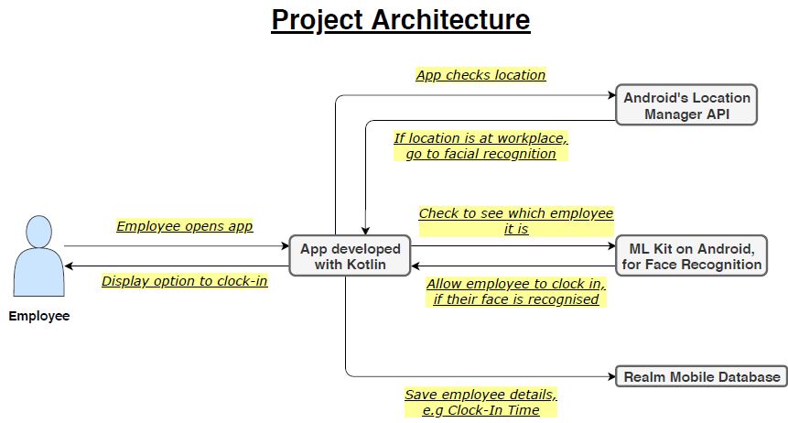
Project Architecture

Slide 4
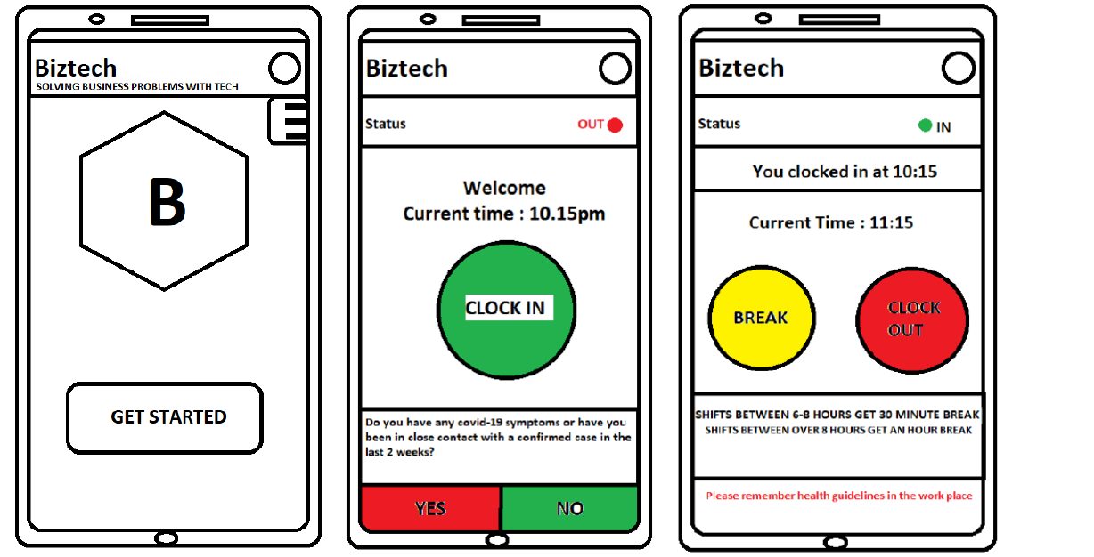
Our Prototype

Slide 5
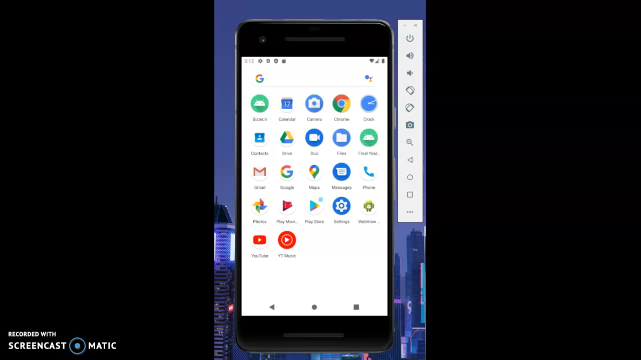
Our Prototype

Slide 6
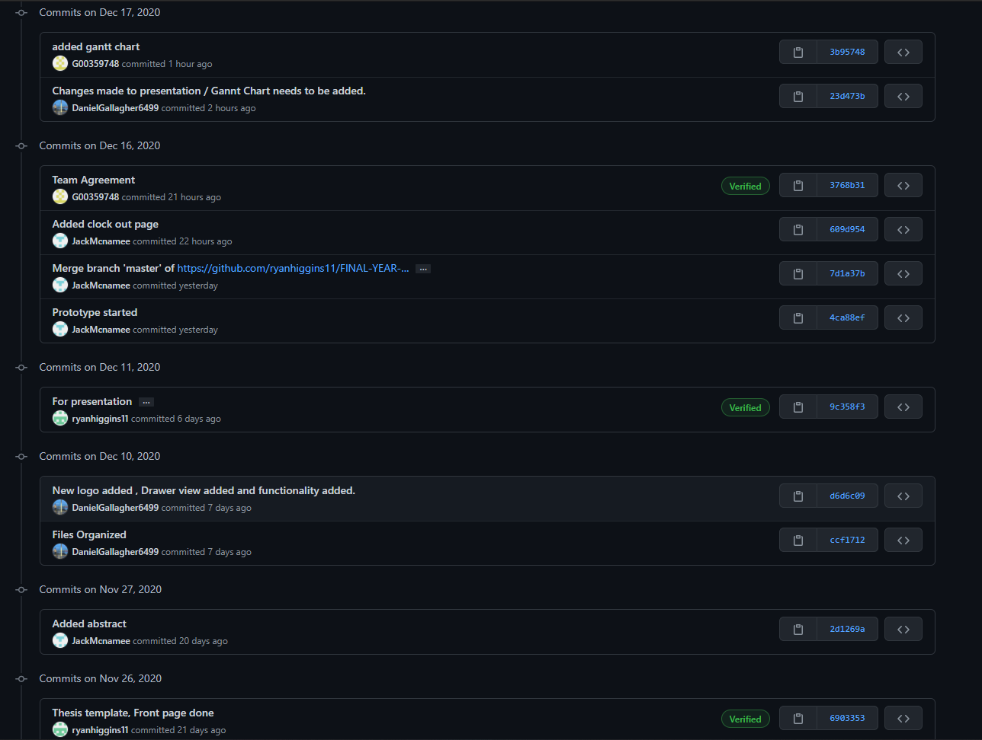
Git Commit History https://github.com/ryanhiggins11/FINAL-YEAR-PROJECT/commits/master

Slide 7
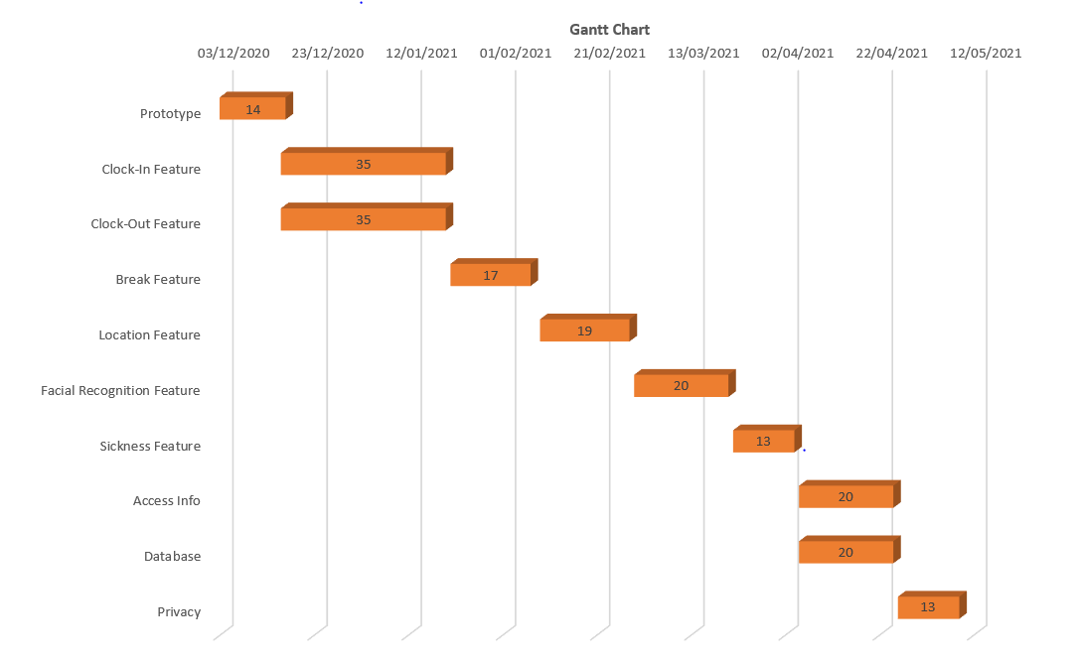
Timeline

